Slide 1
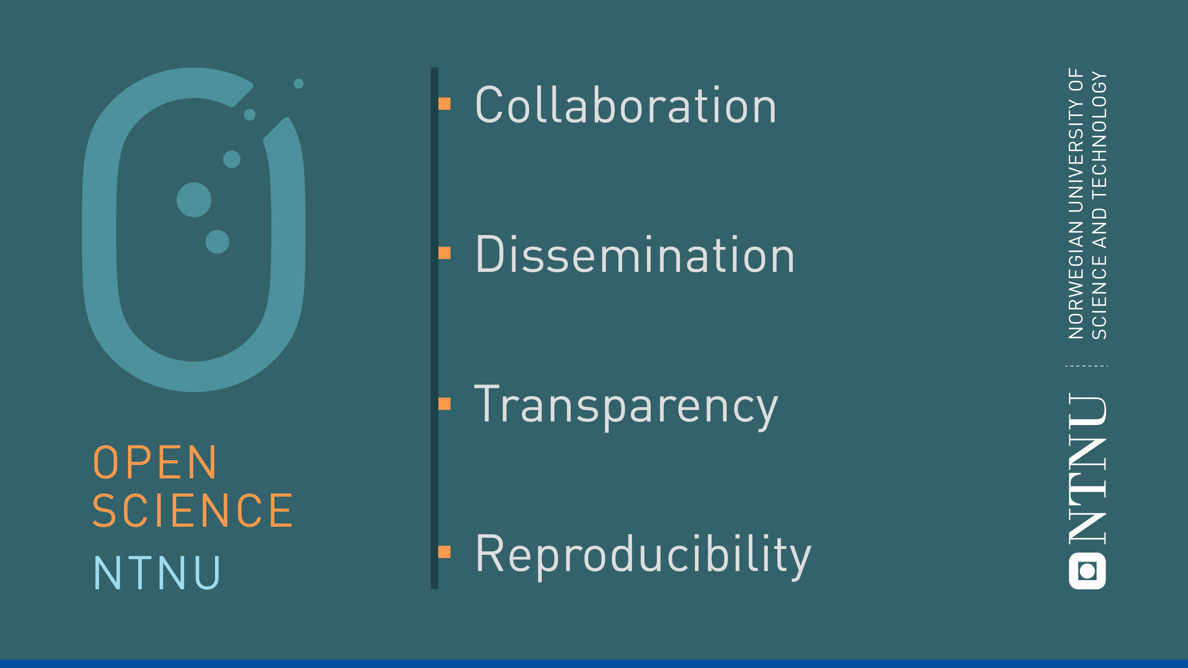
Data management at NTNU
Introduction to data management resources
Ane Møller Gabrielsen
Ingrid Heggland
NTNU University Library

Slide 2
Open Science at NTNU

Slide 3

Open Science at NTNU
New policy for Open Science 2020
Previously: Policy for Open Access (2014) and policy for Open Research Data (2018)
NTNU University Library point of contact and coordination for Open Science at NTNU
Support services, tools, and guidance
Collaboration with IT and departments /faculties

Slide 4
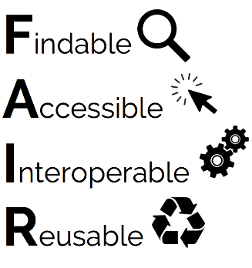
Research data at NTNU:
As open as possible, as closed as necessary
Data should be:
NTNU guarantees for access to infrastructure and support services
The researcher is responsible for the quality
All projects should have a DMP

Slide 5

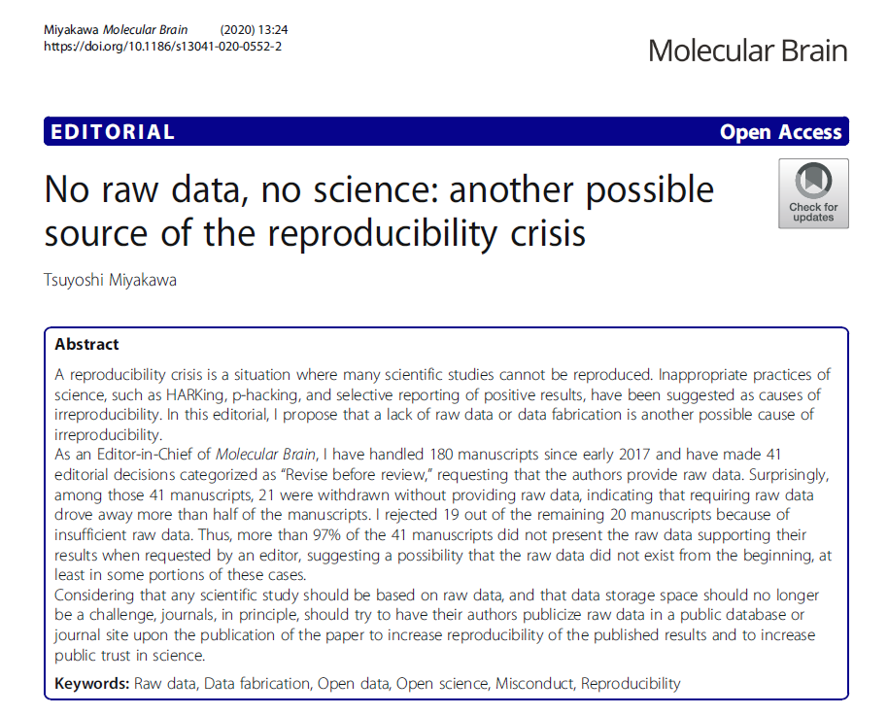
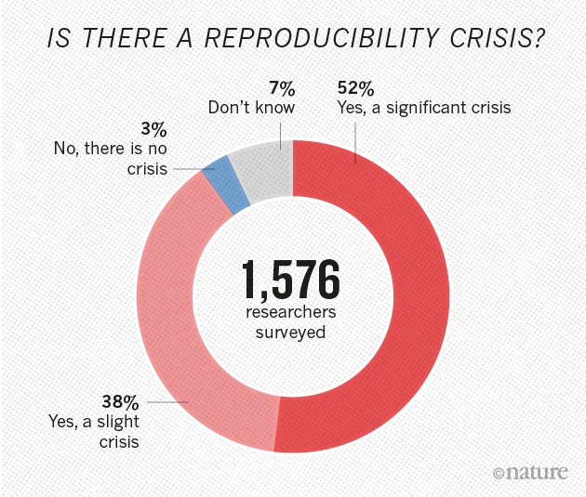
Transparency …
1,500 scientists lift the lid on reproducibility
Survey sheds light on the ‘crisis’ rocking research.
Monya Baker
Nature 533, 452–454 (26 May 2016) doi:10.1038/533452a
Notes:
Hypothesizing After the Results are Known

Slide 6
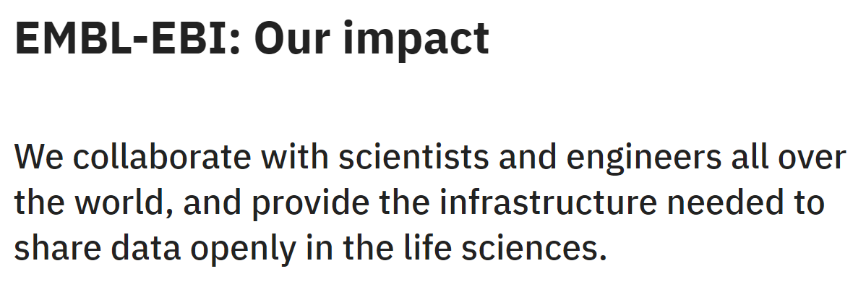
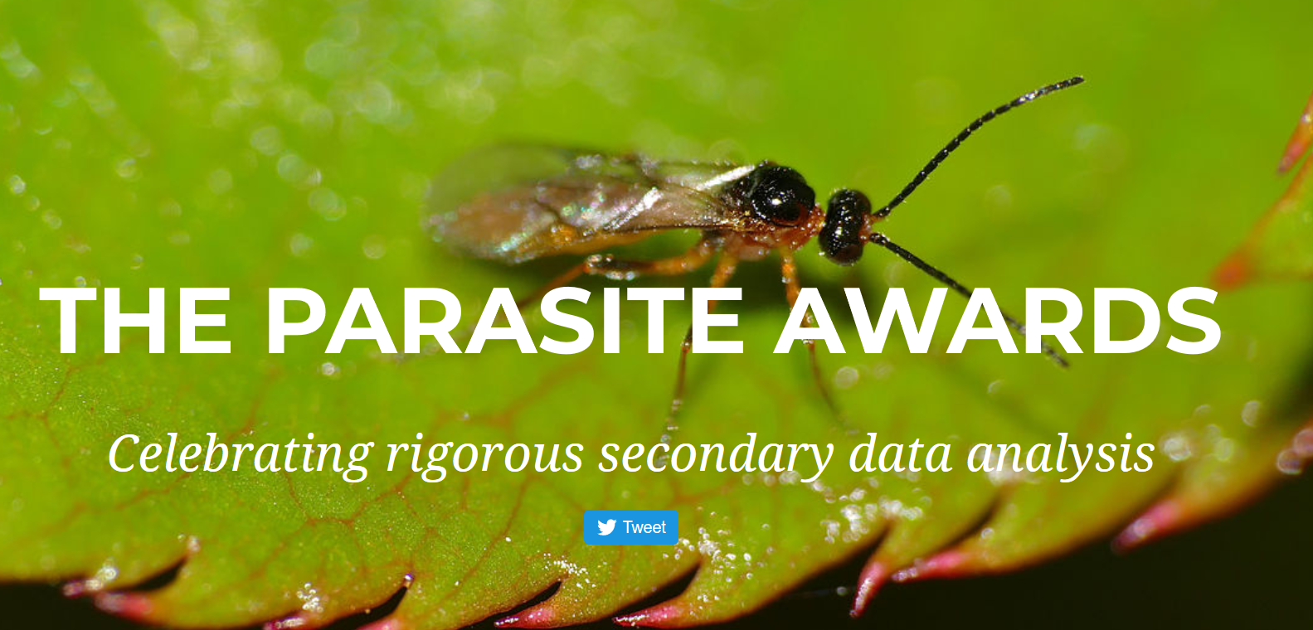
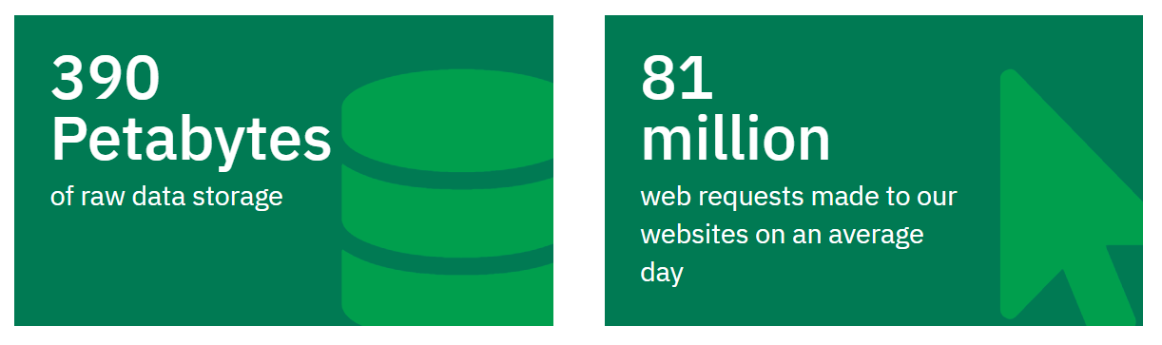
… and reuse!
Where to find data?
BASE (Bielefeld Academic Search Engine)
www.base-search.net
DataCite
search.datacite.org
Elsevier Data Search
datasearch.elsevier.com
Google Dataset Search
https://datasetsearch.research.google.com/
Registry of Research Data Repositories
re3data.org

Slide 7
NTNU Storage and Computing Resources

Slide 8
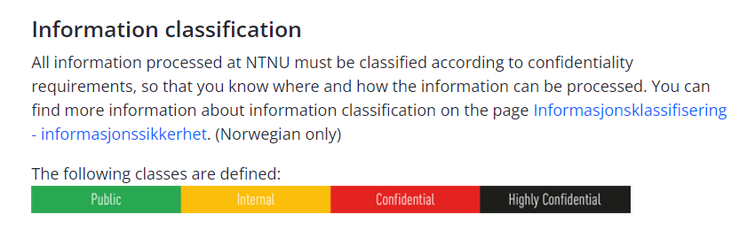
Storage: Information Security
All information (including research data) should be classified, to help choose the correct storage
Open, Internal, Confidential, Highly confidential

Slide 9
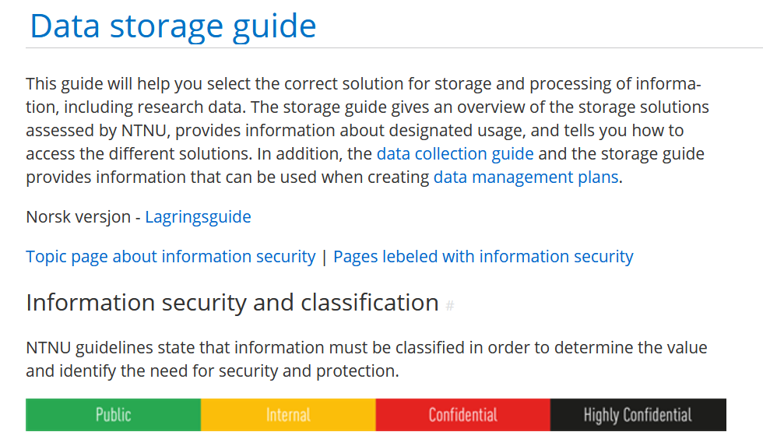
Confidentiality: How important is it that the information does not fall into the wrong hands?
Open
Internal
Confidential
Strictly Confidential
Integrity: How important is it that the information is not modified by unauthorised persons or by accident?
Accessability: How critical is it to lose access to the information for a period of time, or to lose it completely? (Example: If you store your data on M:, no one can access it if you quit.)

Slide 10
Classification of research data
Most research data will be classified as internal, but some types require more protection
Examples:
Trade secrets
Data for commercial purposes, patents etc
Special categories of personal data

Slide 11
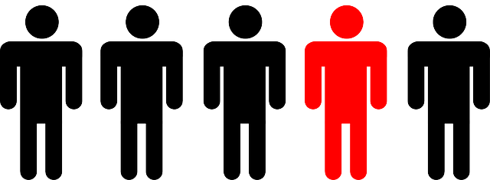
Personal data:
Any information that identifies a physical person, directly or indirectly
Examples:
Name, ID-number, address, telephone number etc.
IP-address, location information
Images, sound, video, email, voice …
Background information that can be traced back to an individual, (e.g., institutional affiliations combined with information about age, sex, occupation, nationality, and so forth)
Special categories of personal data (sensitive):
Race or ethnic origin
Political opinions, religion, philosophical beliefs, union membership
Sexual orientation and activity
Criminal offence data
Genetic and biometric data used for identification purposes
Health data
Notes:
Generell definisjon
Særlige kategorier av personopplysninger
→ Behandle

Slide 12
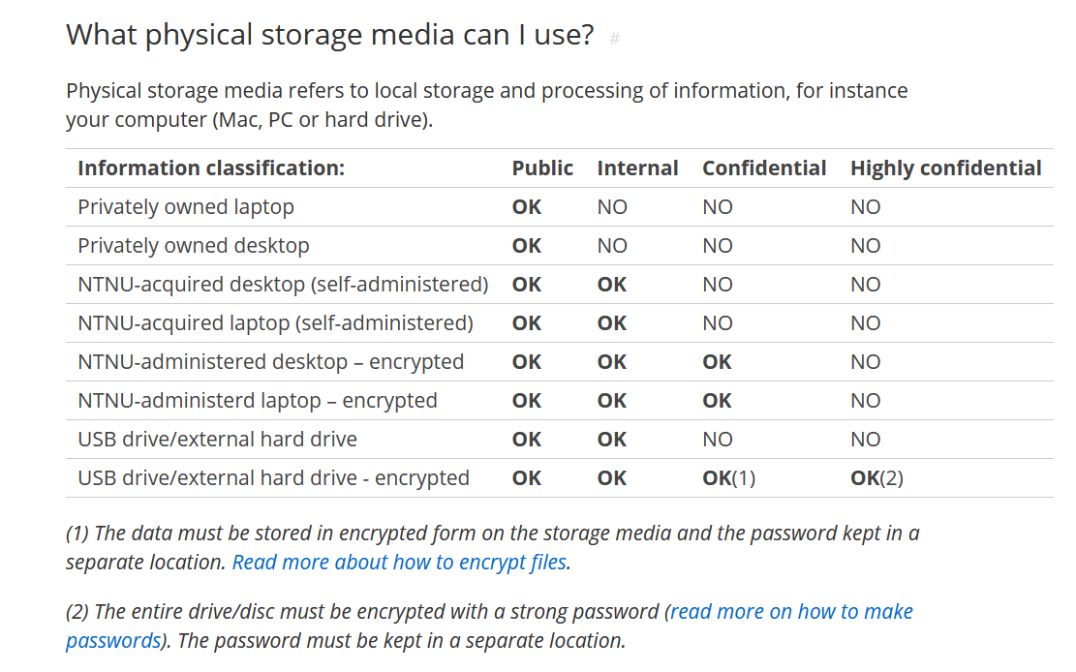

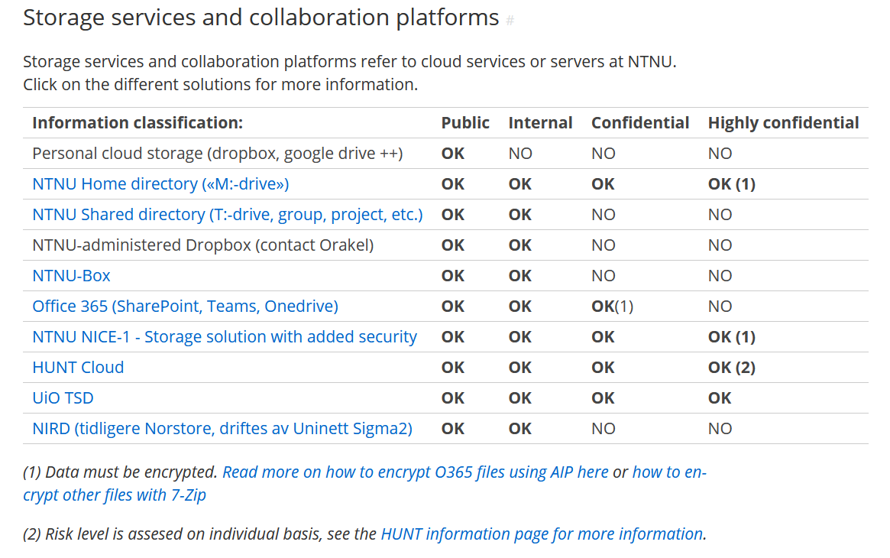
https://innsida.ntnu.no/wiki/-/wiki/English/Data+storage+guide

Slide 13
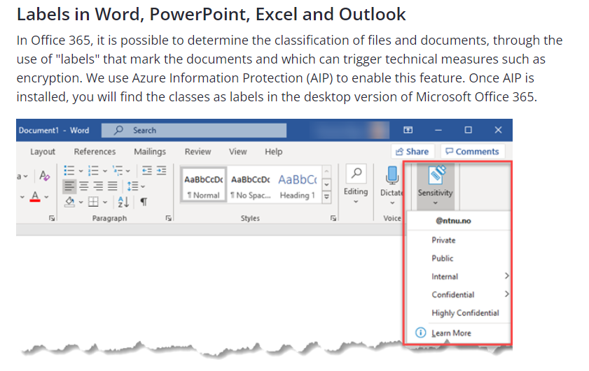
Encryption through AIP (Office 365)

Slide 14
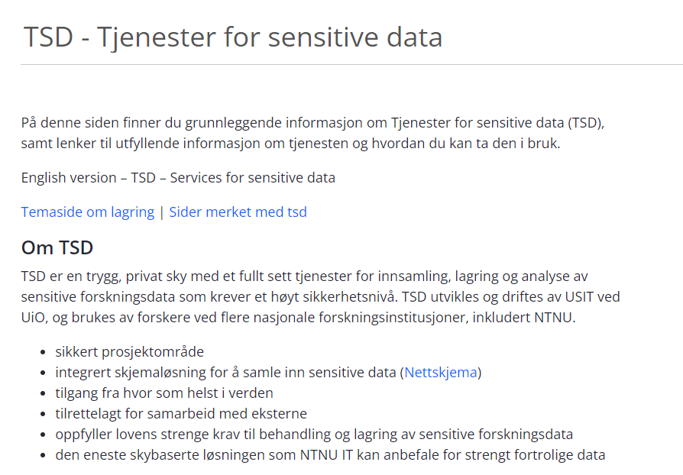
TSD: Secure environment for confidential and highly confidential data
NTNU has an agreement with UiO for TSD usage
Order project room from Innsida: https://i.ntnu.no/wiki/-/wiki/Norsk/TSD+-+registrere+nytt+prosjekt

Slide 15
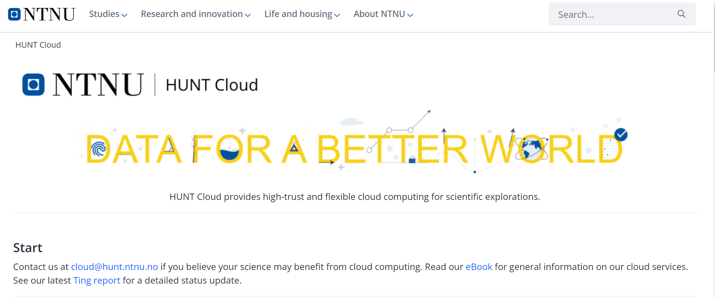
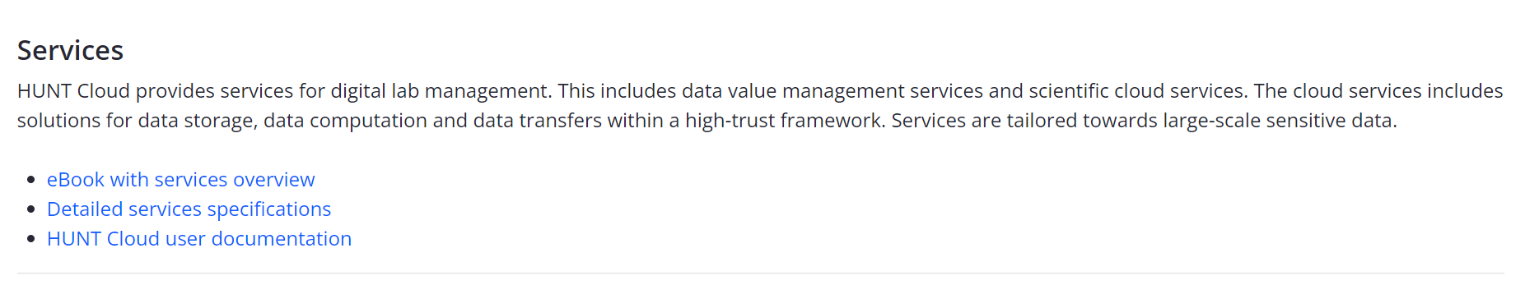
HUNT Cloud: Secure services for confidential data (health data, genomics etc)

Slide 16




Research
Software
Engineering
Laboratory Instrumentation
and Support
RSE
LAB
NTNU IT – Research Support
IT support for PhD students
High
Performance
Computing
HPC
Mime

Slide 17
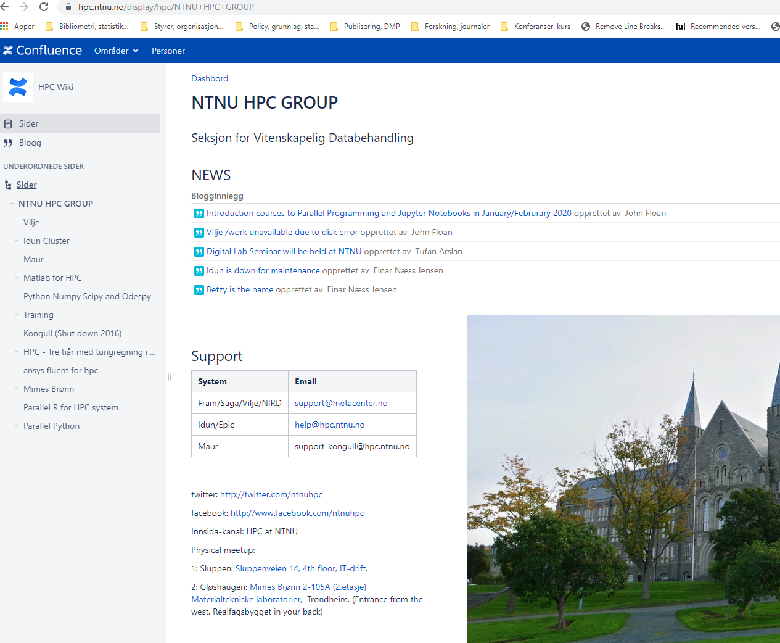
RSE
LAB
High
Performance
Computing
HPC
Mim
HPC

Slide 18
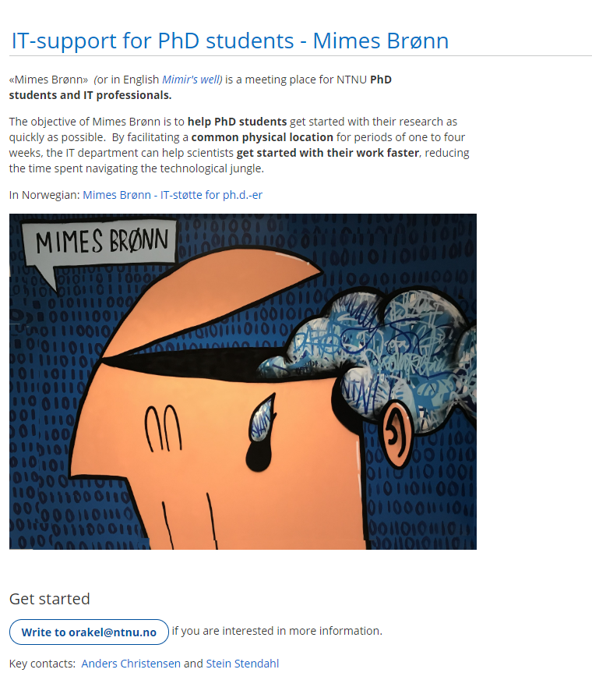
RSE
LAB
IT support for PhD students
Mime
HPC

Slide 19
NTNU Open Research Data
DataverseNO

Slide 20
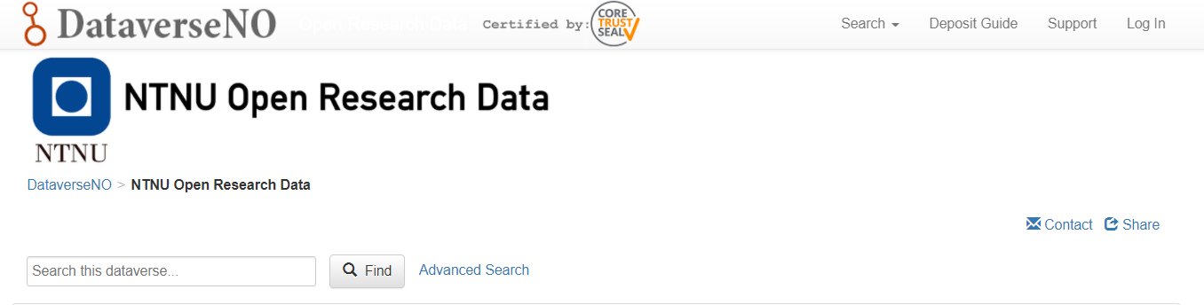
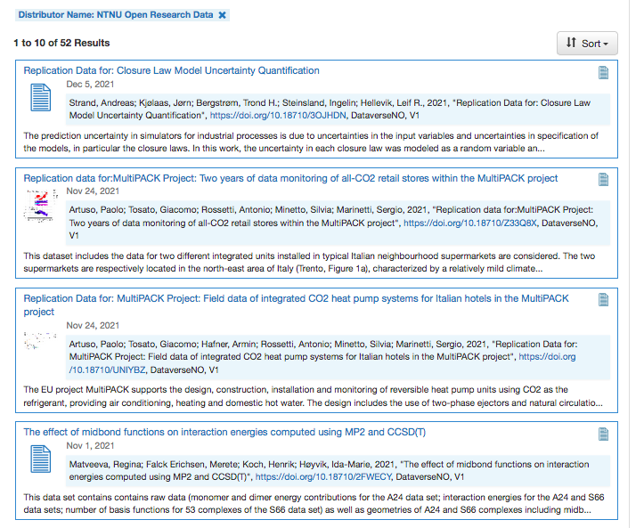
For data that does not fit into disciplinary or domain specific archives/repositories

Slide 21
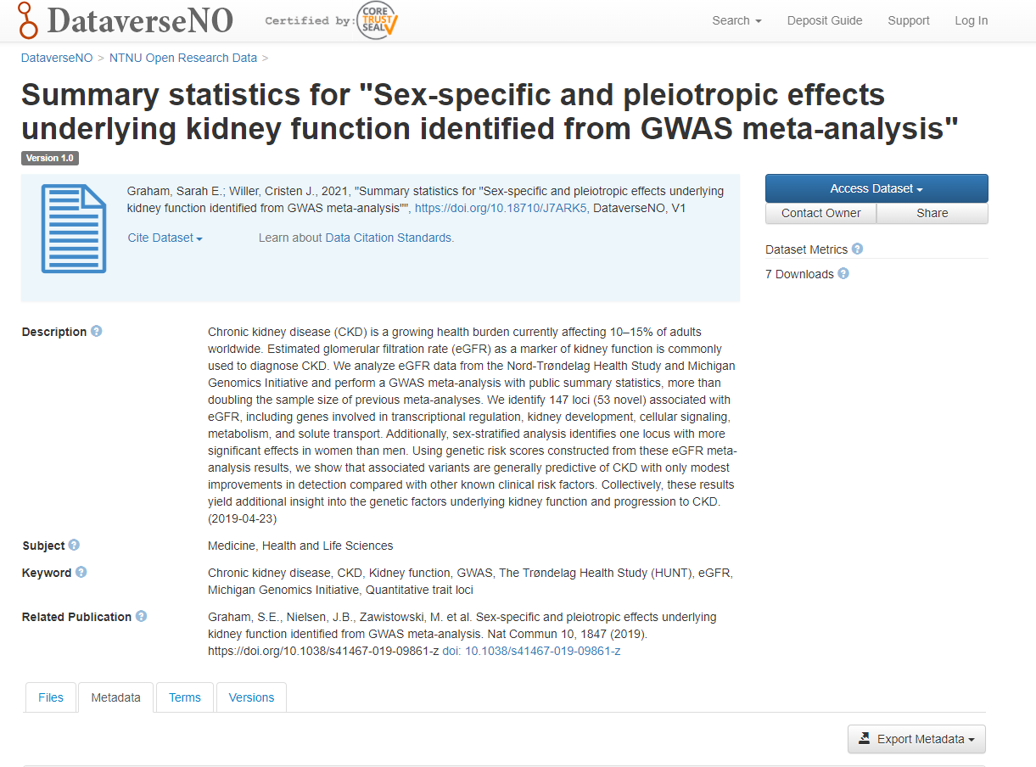

Slide 22
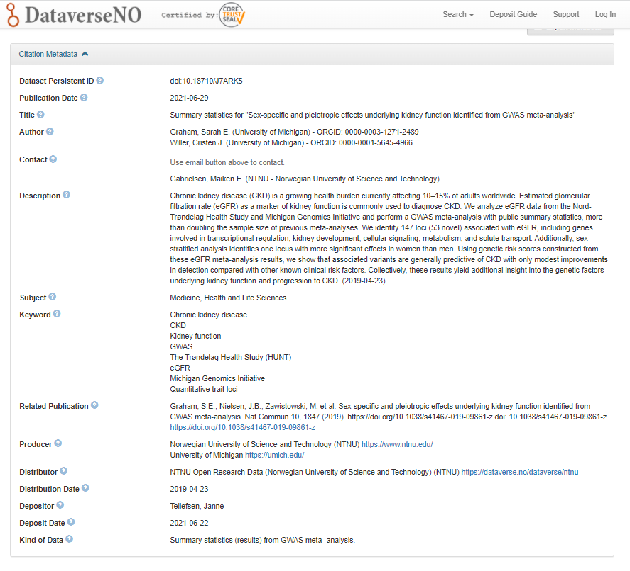
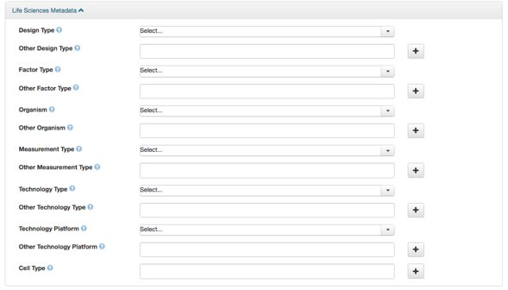
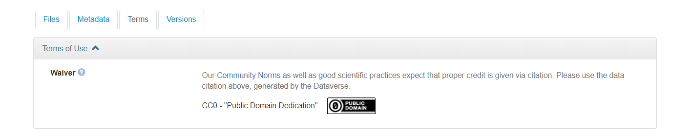
Ensures FAIRness

Slide 23
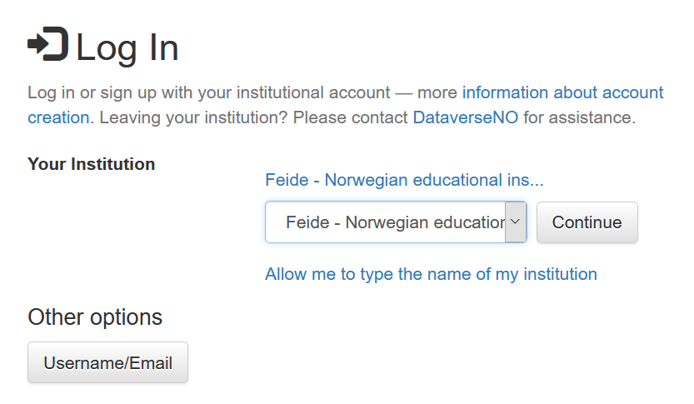
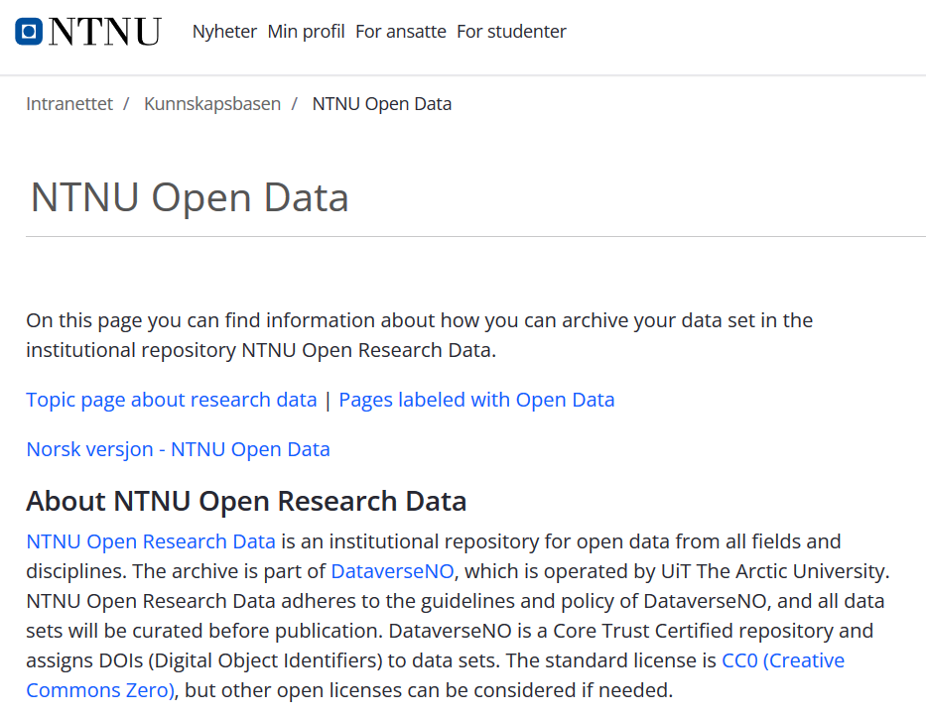
Log in with FEIDE user (NTNU user), see wiki for further information on how to publish data.

Slide 24
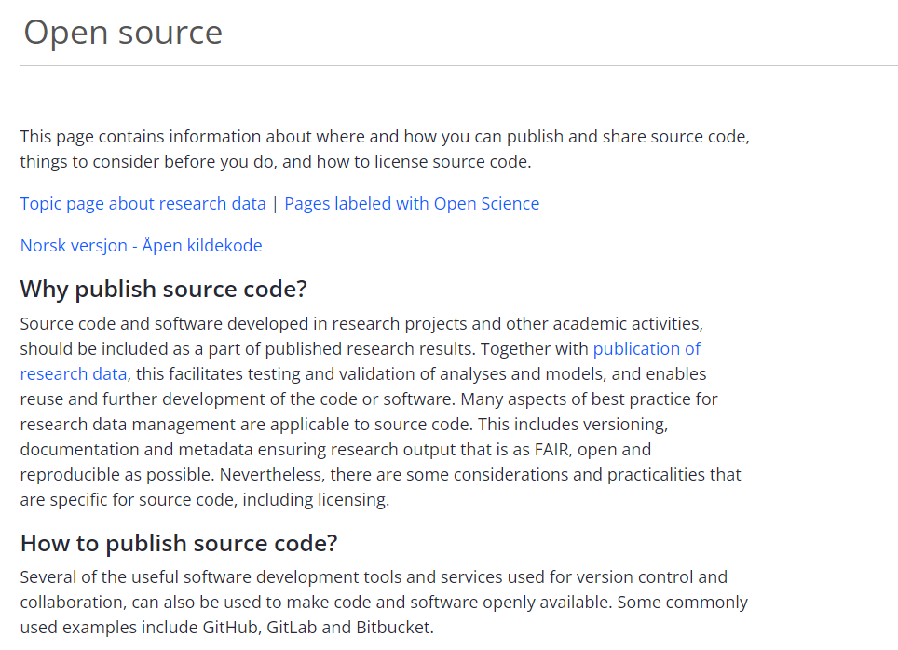
Open Source

Slide 25
Help & Support

Slide 26
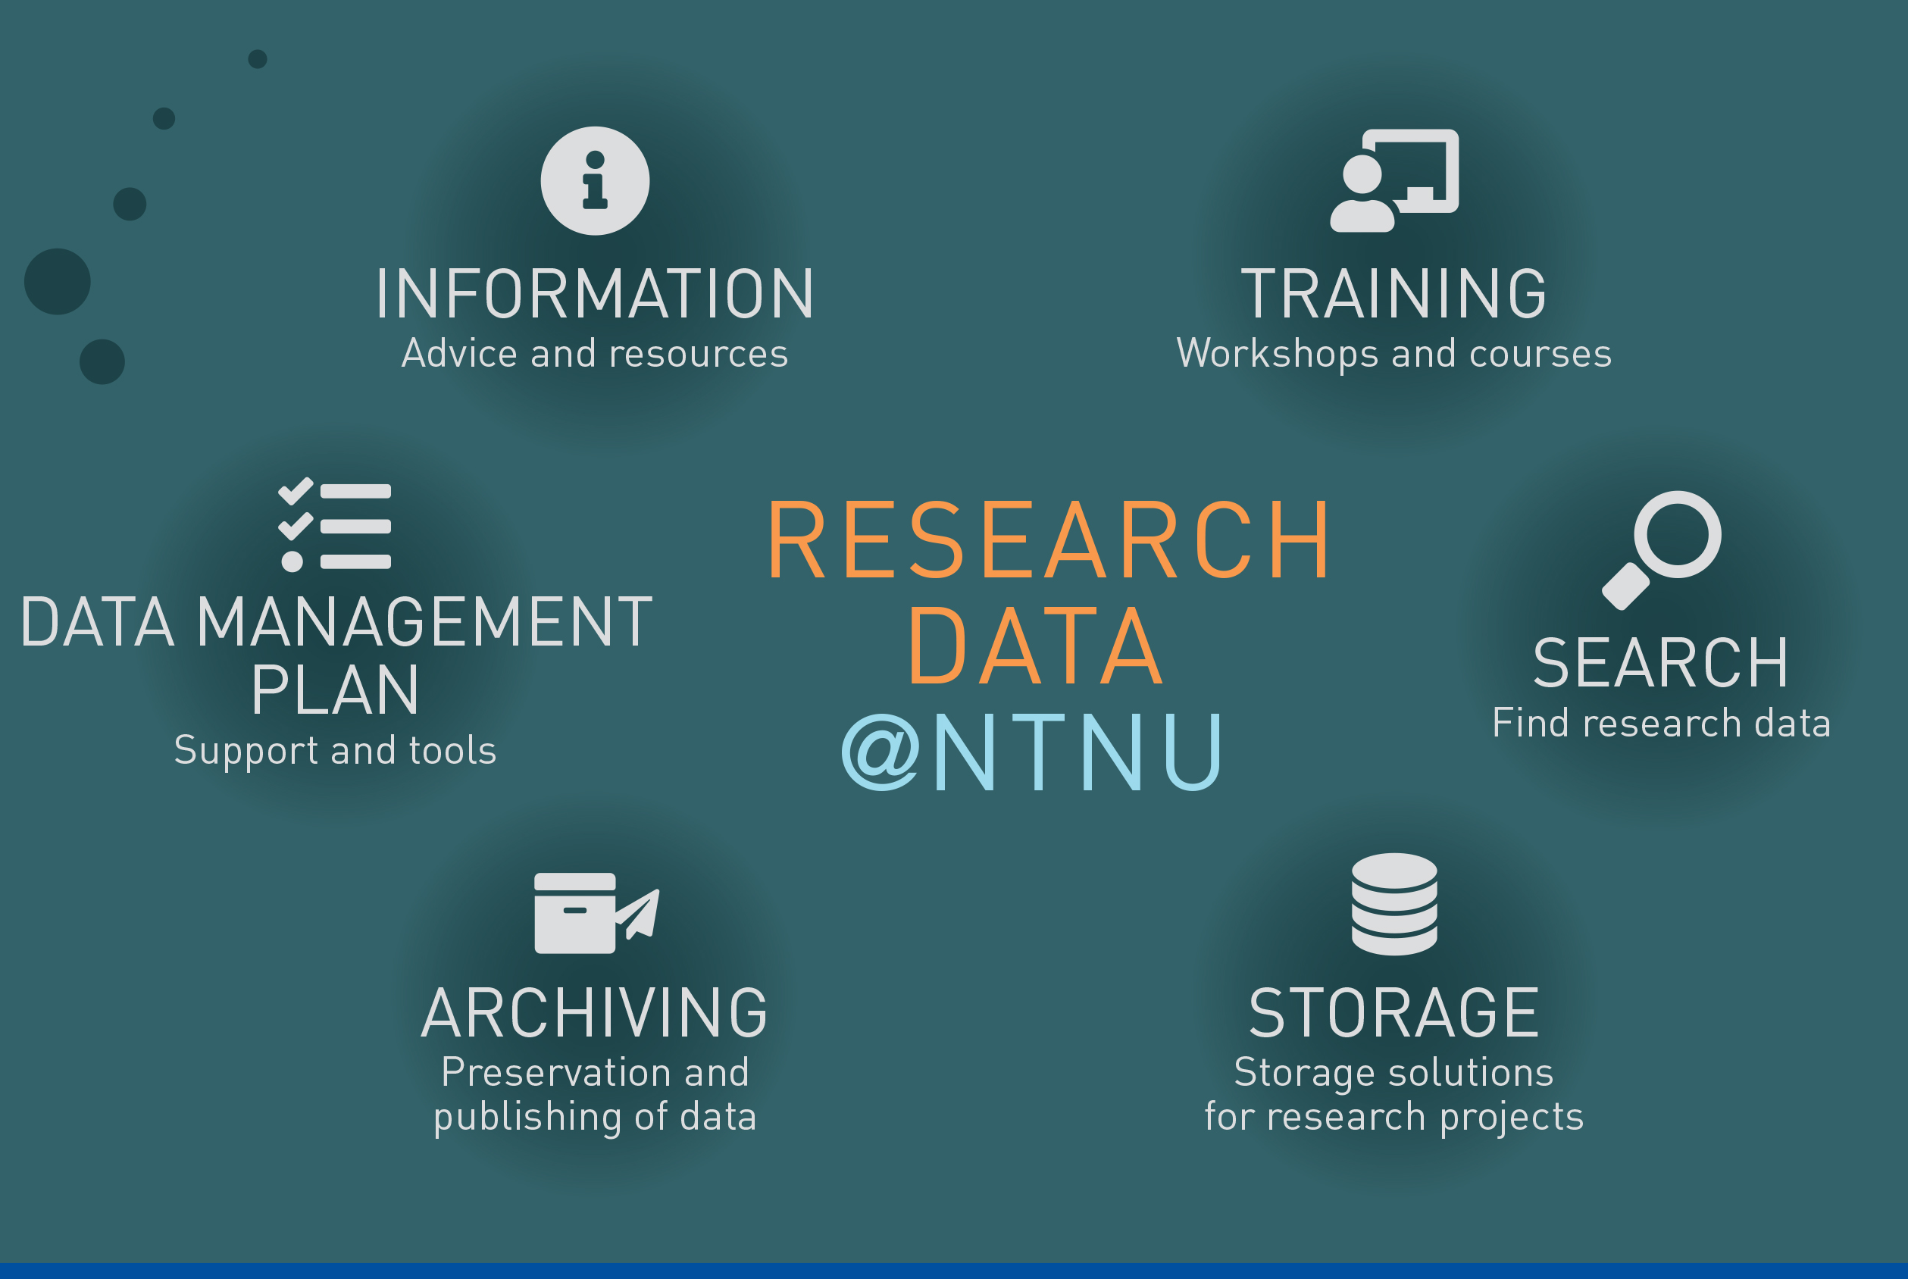
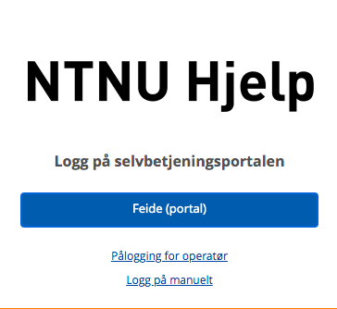
Support and guidance: Research Data @NTNU
Central support service for research data
Coordinated by the library in close collaboration with IT
Support for data management throughout the data lifecycle

Slide 27
